Slide 1
Walmart Sales Forecasting
MGMT 59000-146 – Machine Learning
2/20/2024

Slide 2



Walmart Sales Forecasting – Overview
Objective – Develop a predictive model to forecast daily sales for the food category over the next 28 days.
42,840 time series
Walmart Hierarchical Sales Data
Days (1 – 1941) '2011-01-29’ to '2016-06-19’
Notes:
no of 5 star ratings, cancellations, response rates

Slide 3


Agenda
2. Exploratory Data Analysis (EDA)
1. Data Description
3. Feature Engineering
4. Modeling
5. Insights, Recommendations and Future Scope

Slide 4



Project team
Shivam Mishra
Ashvin Raj

Slide 5
1. Data Description

Slide 6

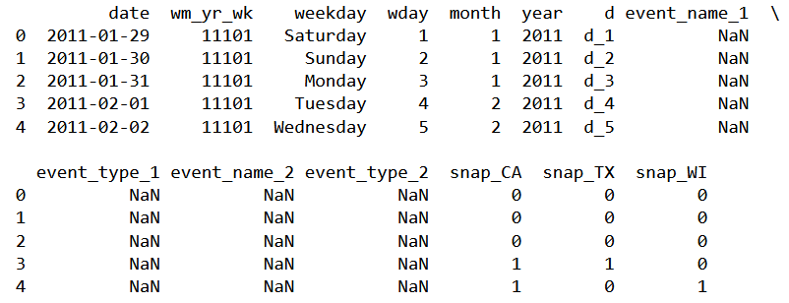
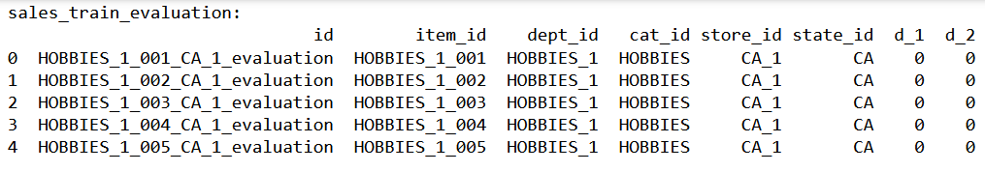
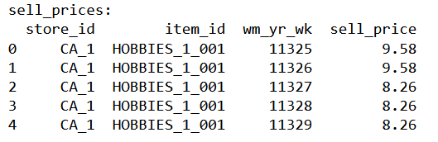
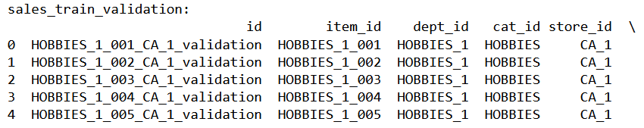
Data Files
1. calendar.csv
2. sales_train_evaluation.csv
3. sell_prices.csv
4. sales_train_validation.csv

Slide 7
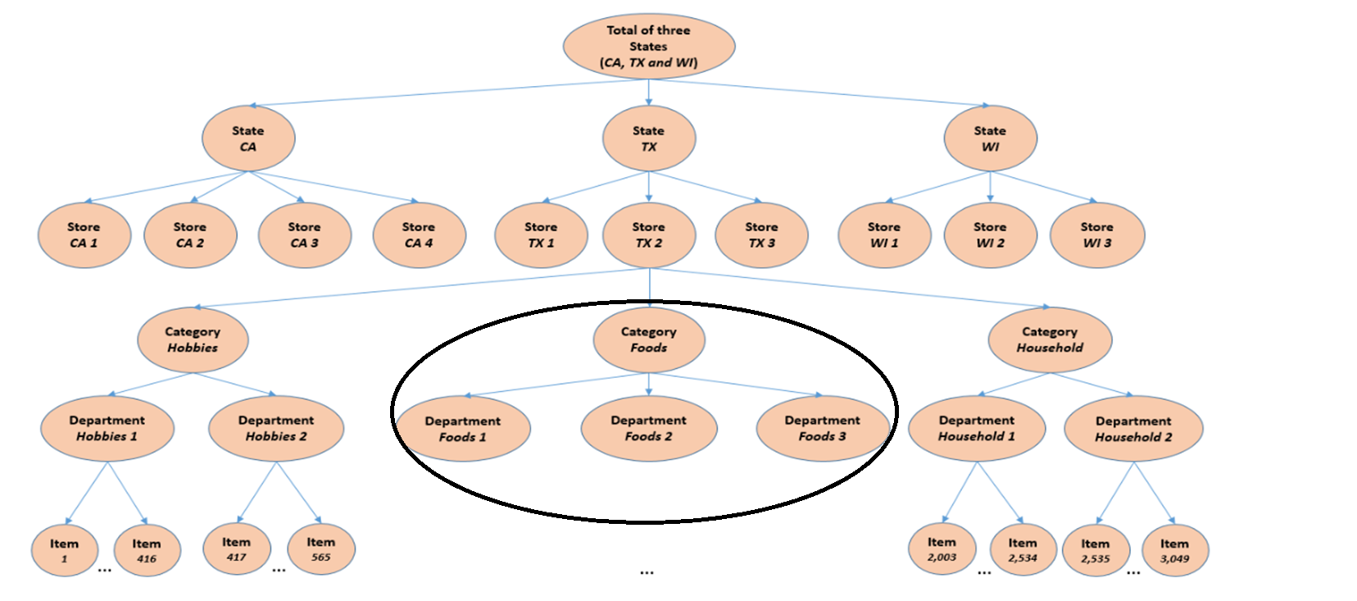
Data Overview
Flow Chart

Slide 8
2. Exploratory Data Analysis (EDA)

Slide 9

Descriptive Data Analysis
1. Sampling

Slide 10
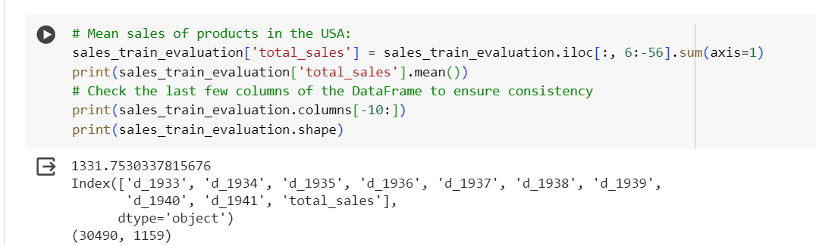
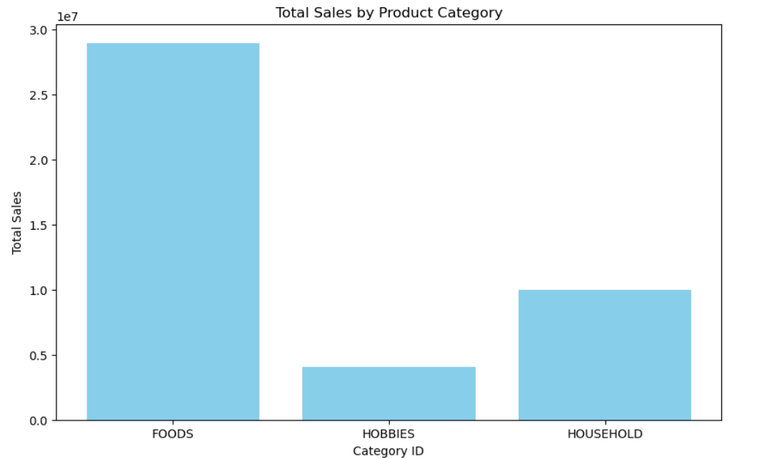
Descriptive Data Analysis
1. Mean sales of products in the USA
2. Sales by Categories

Slide 11
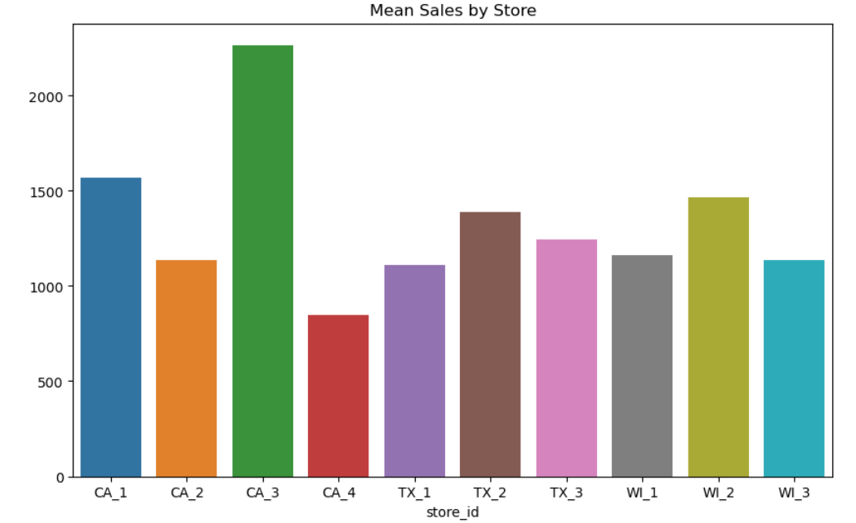
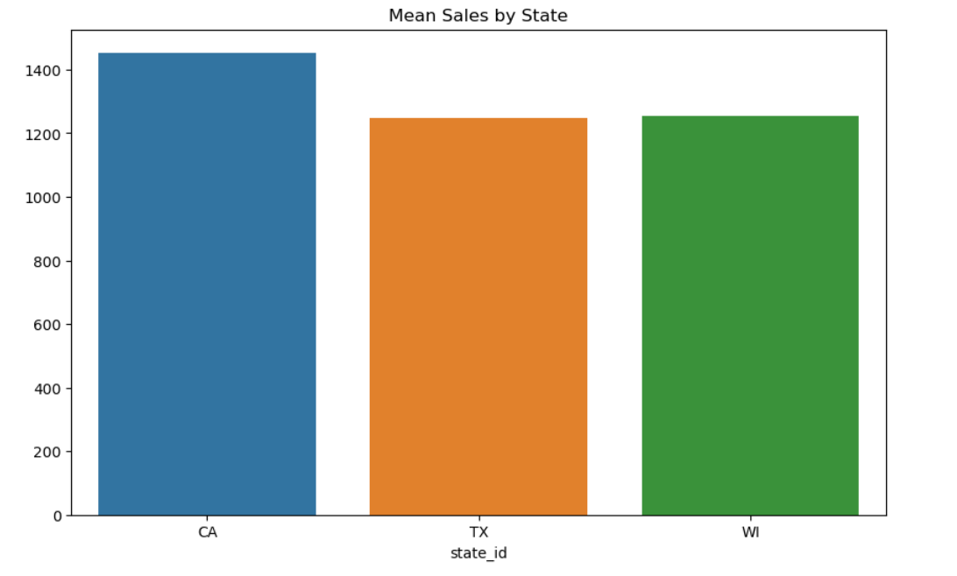
Descriptive Data Analysis
3. Mean sales by stores
4. Mean Sales by State

Slide 12
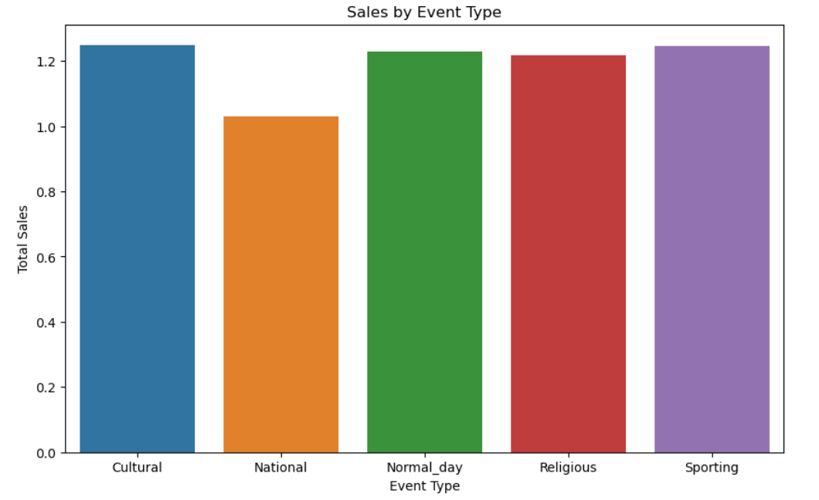
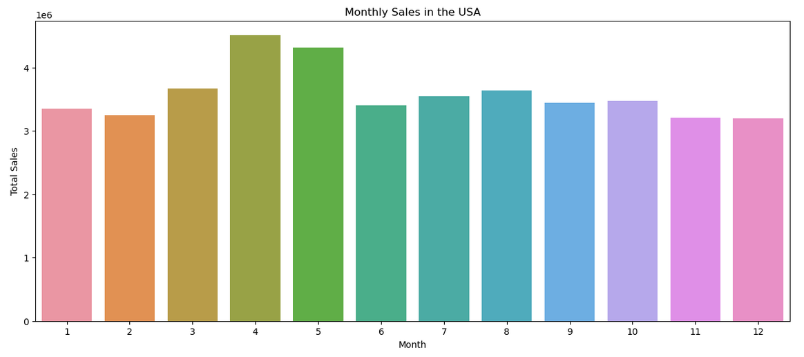
Descriptive Data Analysis
5. Sales by Event Type
6. Month on Month Sales Trend

Slide 13
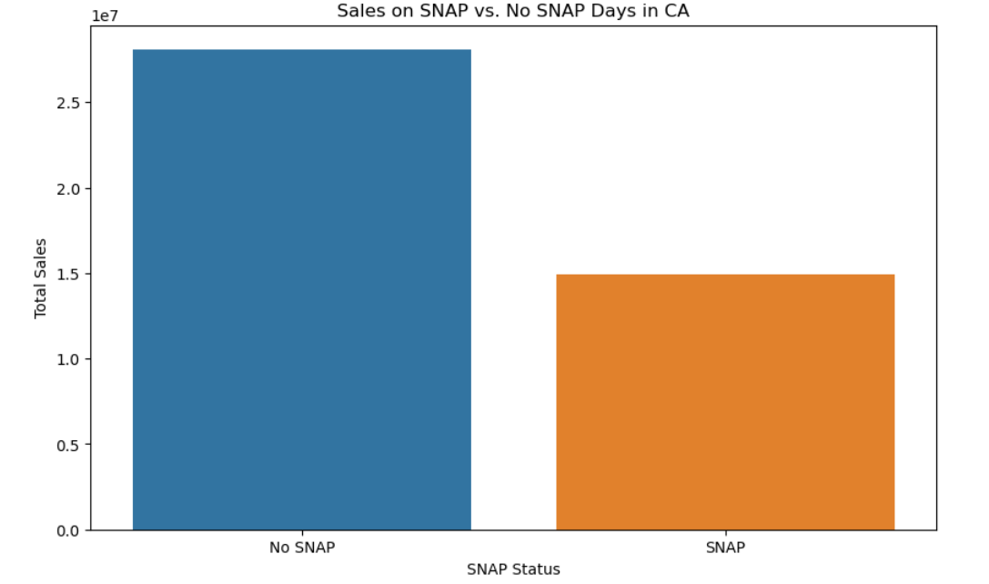
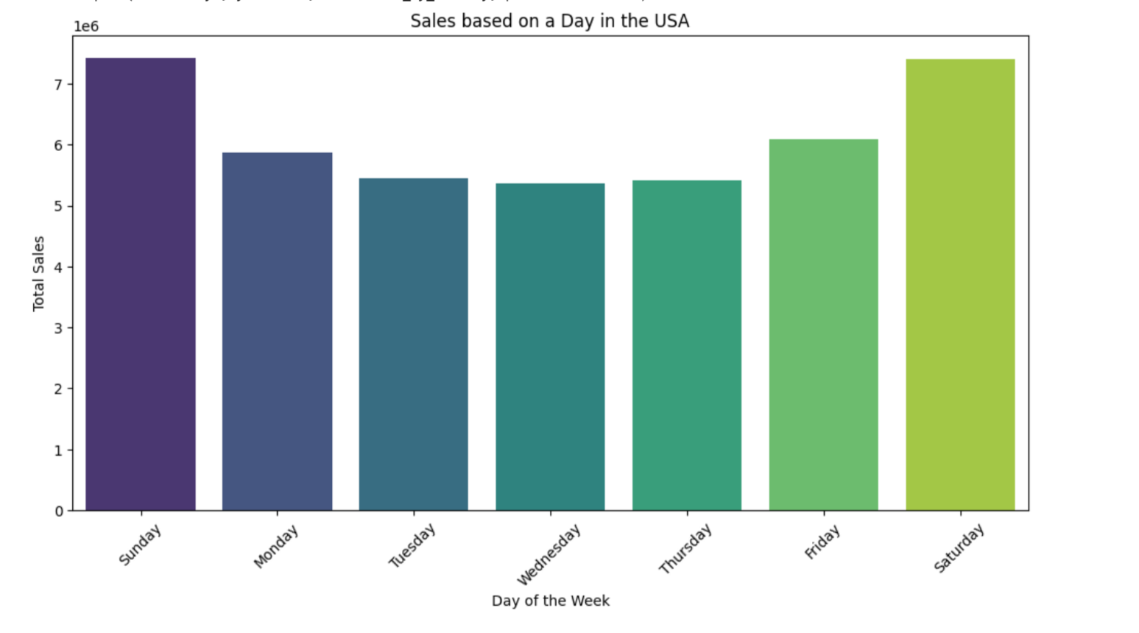
Descriptive Data Analysis
7. Sales on Days with and Without SNAP Benefits
8. Day on Day Sales in the USA

Slide 14
3. Feature Engineering

Slide 15

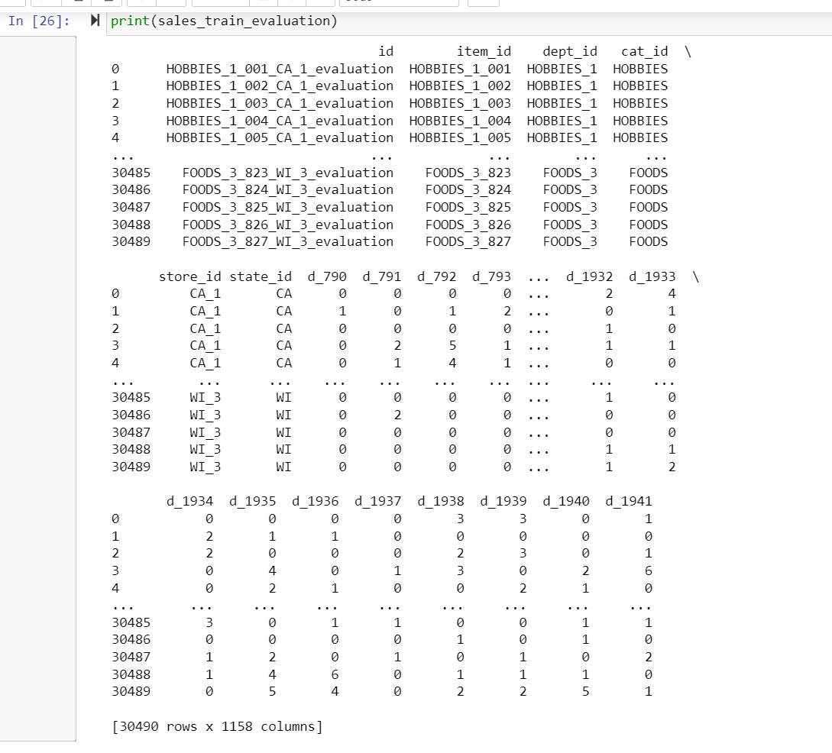
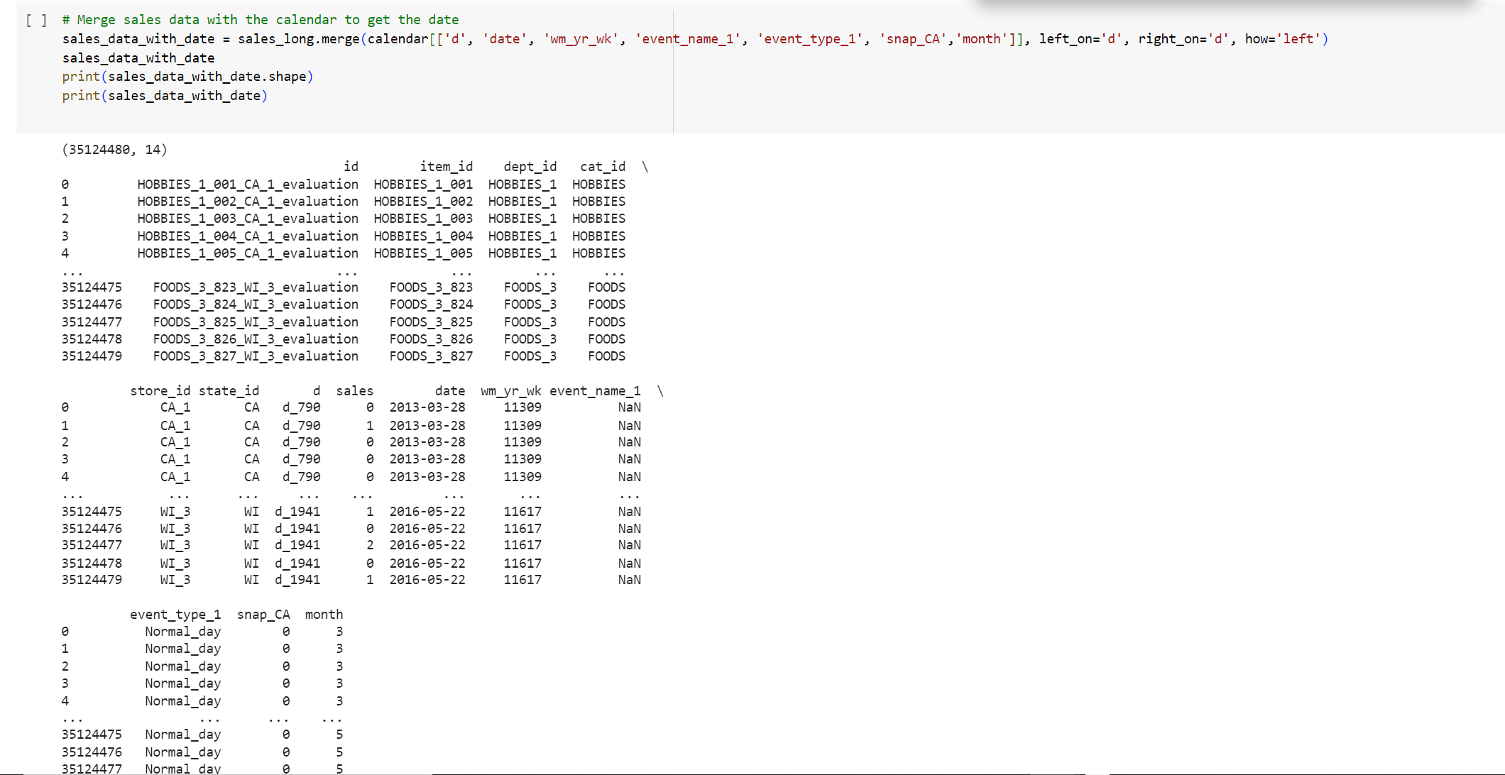
Feature Engineering
Before melt:
After melt:

Slide 16
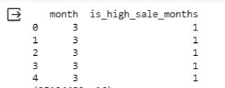
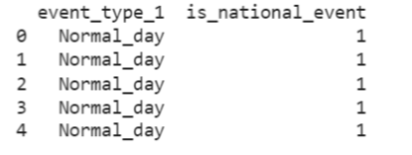
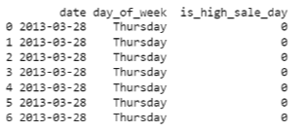
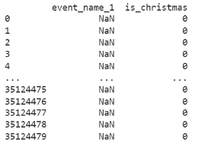
Feature Engineering
1. is_high_sale_months
2. is_national_event
3. is_high_sale_day
4. is_christmas

Slide 17
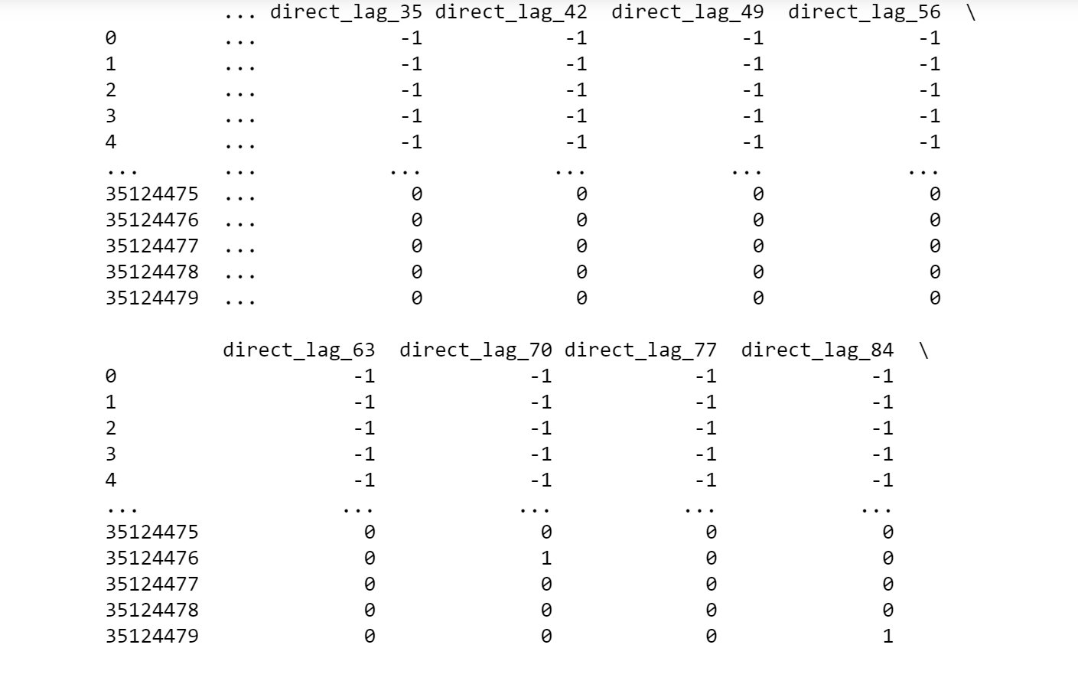
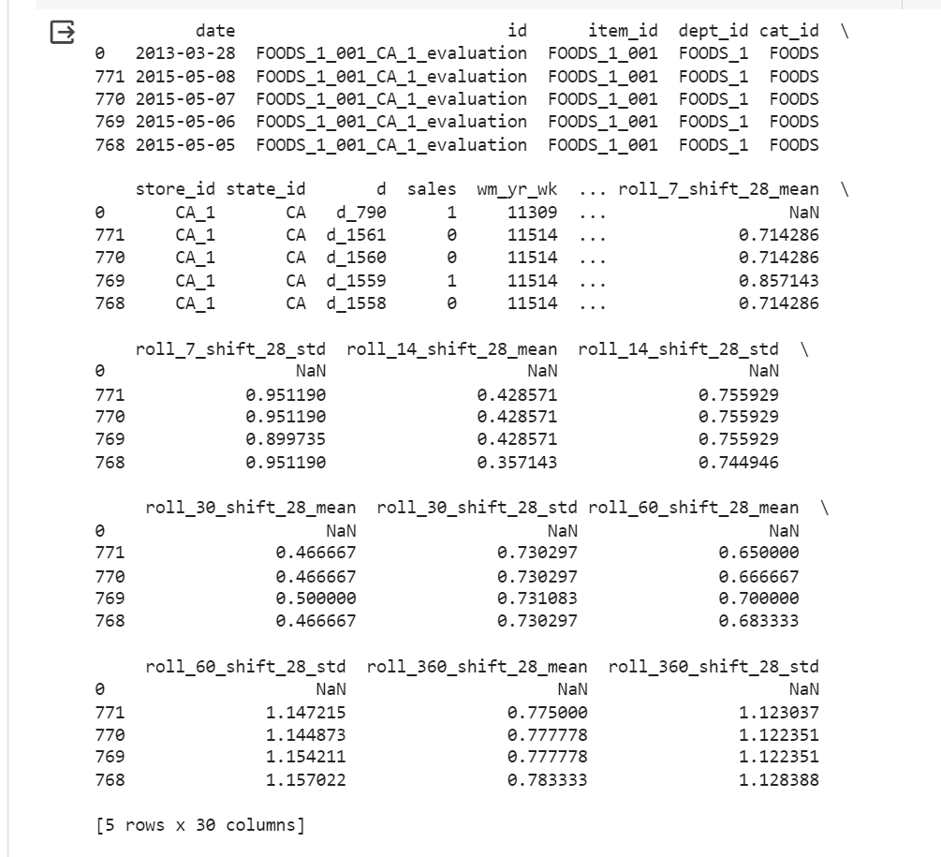
Feature Engineering
5. Lags
6. Rolling
Creates lagged sales features for each item-store combination, capturing sales from past intervals (28 to 100 days in 7-day steps) to inform future sales predictions.
Creates rolling features (mean, SD) from past sales over time windows (7, 14, 30, 60, 360 days) with a 28-day lag to prevent lookahead bias.

Slide 18
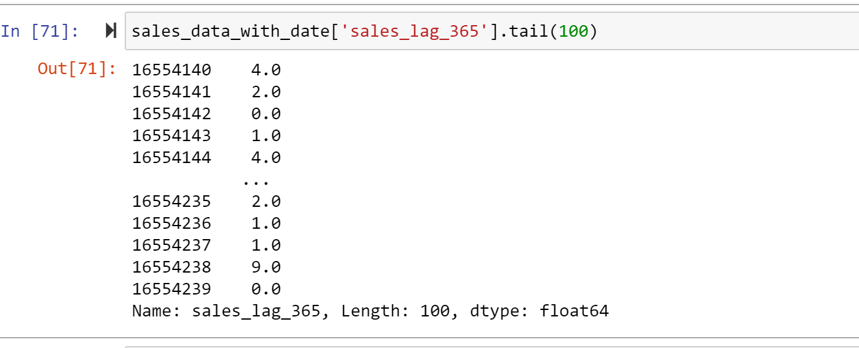
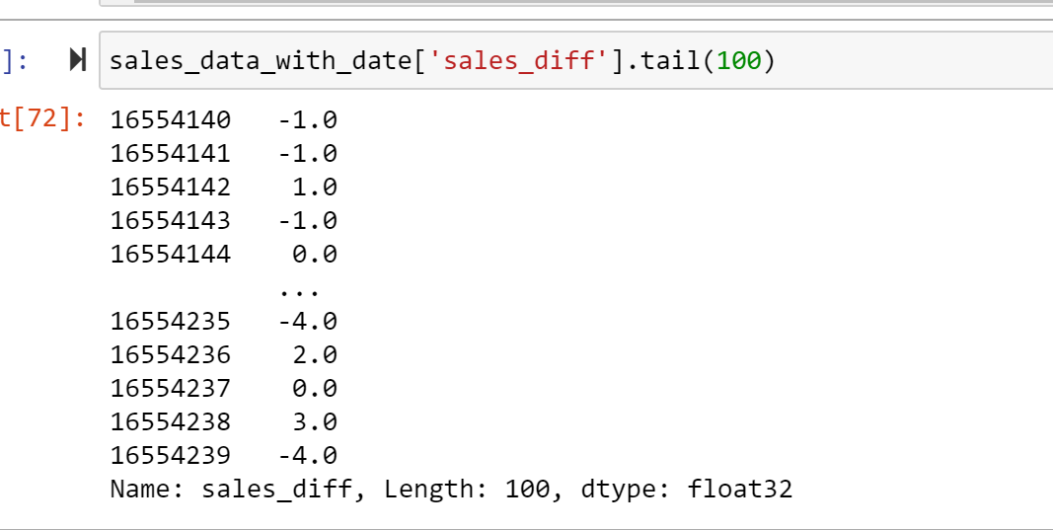
Feature Engineering
7. sales_lag_365
8. sales_diff

Slide 19
4. Model Building

Slide 20

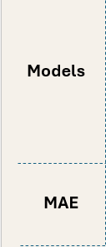
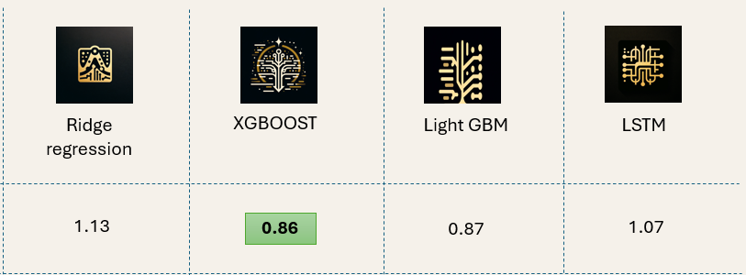
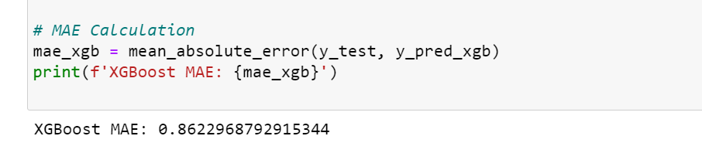
Model Comparison
0.86

Slide 21
LSTM
Feature Engineering: Numerically encodes item_id for embedding, scales numeric features, and one-hot encodes categorical features.
Model Design: Incorporates separate inputs, an embedding layer for item_id, combines features, and uses bidirectional LSTM with regularization and dropout for predictions.
Training Approach: Utilizes Adam optimizer, MSE loss, Early Stopping, and Reduced LR on Plateau for efficient optimization.
LSTM Configuration: Features a 50-D embedding layer, a 64-unit first LSTM layer with L2 regularization, then 32-unit second LSTM layer, dropout (0.5), and batch normalization.
Optimization and Output: Employs Adam optimizer (0.001 learning rate), MSE loss function, and Early Stopping (patience=10) to ensure precise sales forecasting.

Slide 22
XGBOOST
Objective Function: Uses reg: squared error to minimize the squared difference between the predicted and actual values, which is suitable for regression tasks.
Max Depth (max_depth=5): Limits the depth of the trees to prevent overfitting. A depth of 5 allows the model to learn complex patterns without becoming overly specific.
Learning Rate (eta=0.1): Determines the step size at each iteration while moving toward a minimum of the loss function. A rate of 0.1 helps in careful convergence to the minimum, balancing speed and accuracy.
Boosting Rounds (num_round=200): Specifies the number of trees to build. The chosen value reflects an attempt to capture complex patterns in the data.

Slide 23
5. INSIGHTS, RECOMMENDATIONS AND SCOPE

Slide 24

Insights & Recommendations
• LSTM:
• Good at capturing time series trends. Needs well-tuned features and architecture.
• Less effective with complex, non-sequential data.
• XGBoost & LightGBM:
• Excel in structured data via sequential decision trees. Handle diverse data types well.
• Often surpass deep learning in structured tasks.
• Feature Engineering:
• Boosting models better exploit engineered features. LSTMs need extensive preprocessing.

Slide 25
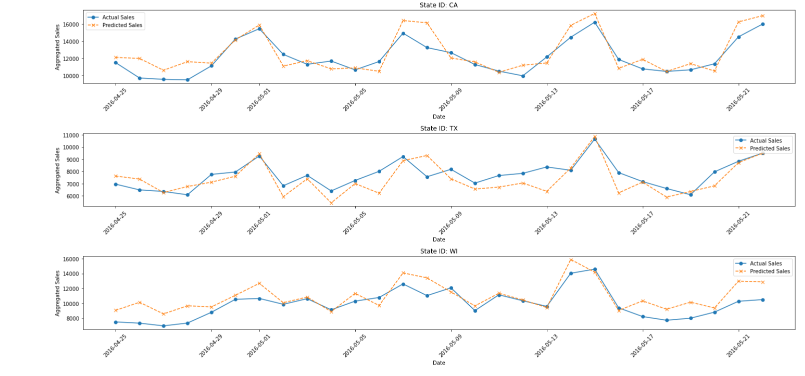
Insights & Recommendations
ACTUAL VS PREDICTED

Slide 26
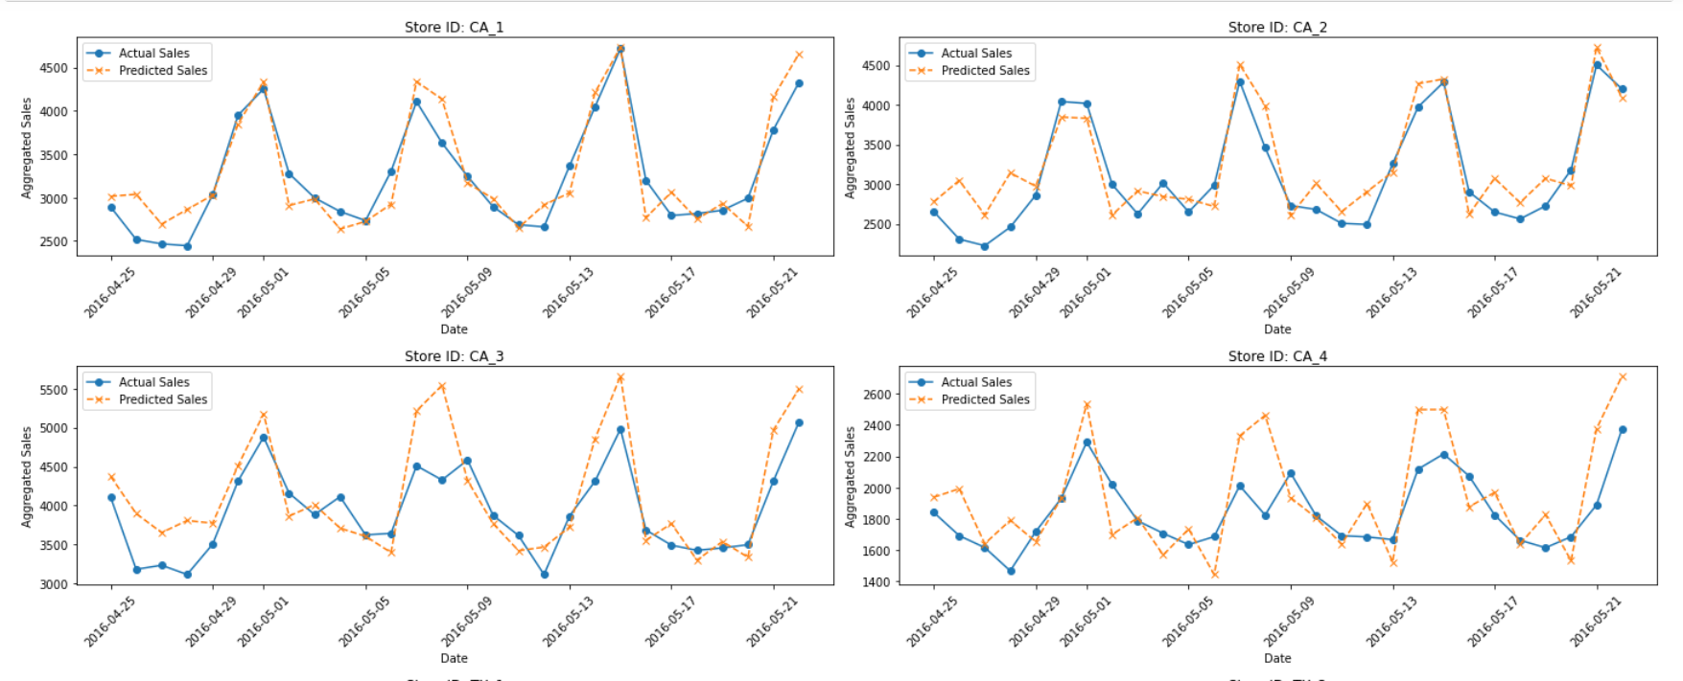
Insights & Recommendations

Slide 27
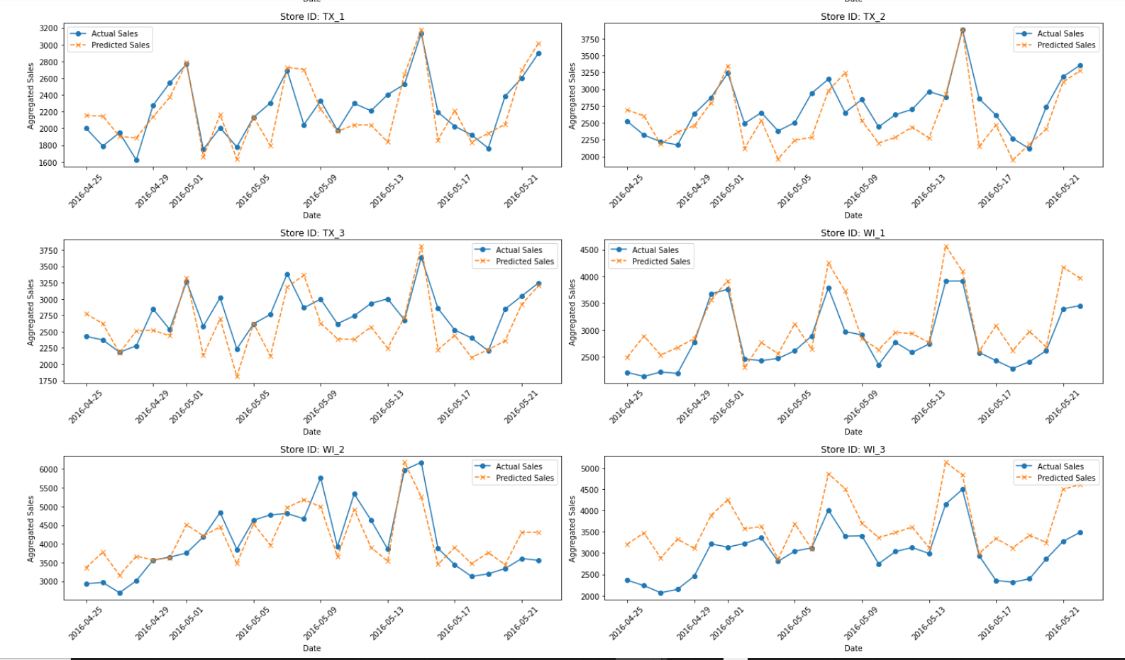
Insights & Recommendations

Slide 28

Future Scope
Comprehensive Data Utilization: Leveraging the entire dataset beyond day 790 could significantly improve model outcomes by providing a more robust data foundation.
Feature Engineering Enhancement: Developing additional innovative features is anticipated to substantially boost model performance.
Model Diversity: Exploring a variety of models such as CNN, RNN, and ARIMA could offer unique insights and potentially enhance predictive accuracy by capturing different data patterns and relationships.

Slide 29
THANK YOU

